Slide 1
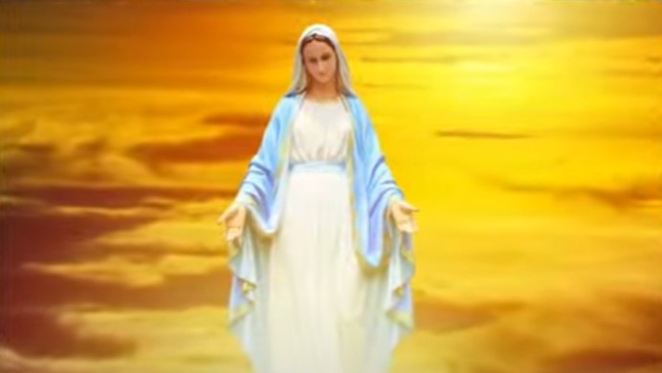
Mary is our model to live in the Divine Will
The Great Lady will form her new Hierarchy similar to the Nine Choirs of Angels
(Vol 35 - August 9, 1937)

Slide 2
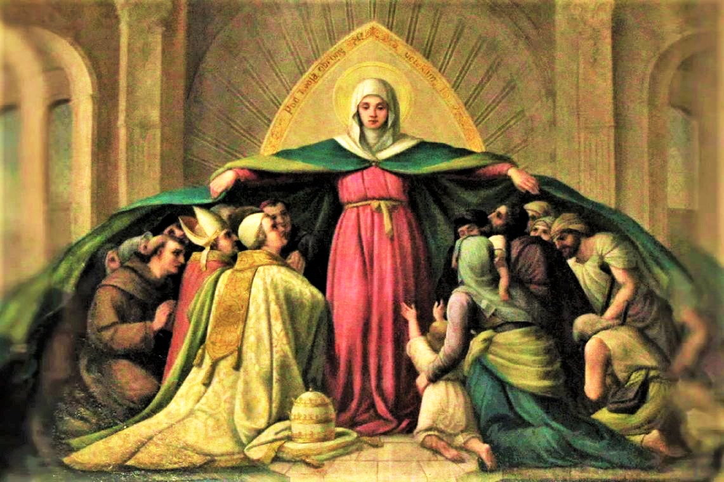
Mary is our mother
Mary is our mother “in the order of grace” (Lumen Gentium 61).
St Pope John Paul II taught us that Mary's maternity is a gift of Christ to each person. She is the personal spiritual mother of each person, and each should take her as his/her mother.
We celebrate her motherhood of the church on the Monday after Pentecost.
“It was not enough for Our Love that the Word would incarnate Himself in order to generate one single Jesus for all and give one single Mother to all the human generations – no, no, Our Love would not have been excessive.
Its race was so fast as to find no one to stop It; and only when, with Its Power, It generated this Mother in each soul, and let Her generate Her Jesus, so that each one would have Mother and Son at his disposal – then did It somehow calm down.” (Vol 34 - December 24, 1936)

Slide 3

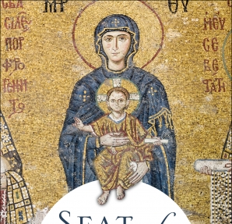
Mary shares in Christ’s prophetic mission
“You have one teacher; the Christ” (Matthew 23:10)
“I behaved with you [Luisa] like a teacher, when he wants his disciple to become perfect, whether in medicine, or in history, or something else: it seems that he cannot speak about anything else; … I assumed the attitude of Teacher of Divine Will, as if I ignored everything else. After I instructed you well, I manifested to you your mission.” (Vol 12 - March 17, 1921)
Catechists must echo Jesus, as an icon of Christ (Directory of Catechesis 112) letting the Holy Spirit, The Teacher within (CT 72; Jn 14:26), to teach in and through them. The one who does this best is Our Blessed Mother Mary.
“She is the Seat of Wisdom”; “She is the masterwork of the mission of the Son and the Spirit in the fullness of time” … in her “the Father found the dwelling place where His Son and His Spirit could dwell among men‟ (CCC 721).
She is the “living Catechism” (Catechesi Tradendae 73).

Slide 4
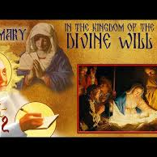
Mary echoes the teaching of Christ
Our Blessed Mother Mary is our most loving teacher (Ecclesiam Suam 57)
She gave Luisa her motherly lessons to live in the Divine Will in the VMKDW and appealed to us:
“If you assure me of your filial love and fidelity, I will remain always with you in your soul, to be your teacher, your model, your example and your most tender mother…
You will no longer be alone because your tender mother will be your sweet companion. With all of my motherly care, I will fulfil my maternal pledge of making you happy. I, who am the Heavenly Empress, will take care of your every need if only you consent to live united with me.”
“And then, since the Celestial Lady is the true Queen of the Kingdom of My Will, it is Her task to help and teach the fortunate creatures who want to enter, to live in It (Vol 24 - May 19, 1931)
In this same BoH diary entry, the Lord tells us that Luisa is similar (not equal) to his Mother Mary. He has elected Luisa as His instrument for the mission of Fiat Voluntas Tua on earth as it is in heaven.
Take Our Blessed Mother as your sweet companion and let her use you with Jesus to spread the Kingdom of the Divine Will, especially among priests and religious.

Slide 5
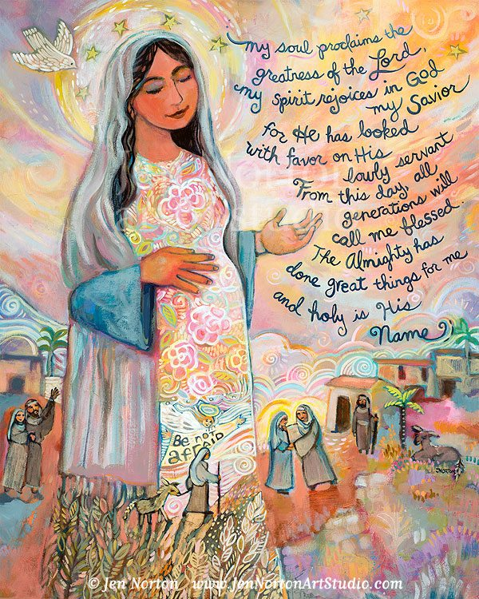
Mary is our Model
Mary is the model of the Church. She is the type/figure of the Church (LG 63).
She is “the model of catechists” (CT 73)
Each soul discovers herself by looking at Mary, for example “your external life is completely ordinary” (Vol 14 - March 16, 1922)
“[The Church's] structure is totally ordered to the holiness of Christ's members. And holiness is measured according to the 'great mystery' in which the Bride responds with the gift of love to the gift of the Bridegroom. Mary goes before us all in the holiness that is the Church's mystery as ‘the bride without spot or wrinkle.’ (Eph 5:27) This is why”
the ‘Marian’ dimension of the Church precedes the ‘Petrine.’” (CCC773; John Paul II, MD 27)
“Now you [Luisa] must stand in for Her … for the Kingdom of my Will. So, the Mama stood in for the daughter, and the daughter stands in for the Mama.”
She helps us with her powerful motherly seas and makes up for our lack:
“More so, since the Queen of Heaven was the first daughter of my Will, and because She always lived within Our boundaries, She formed her seas of love, of graces, of adoration, of light.
Now, since you [Luisa] are the second daughter of my Will, what is Hers is yours, because your Mama keeps you as a birth from Herself, and She enjoys that her daughter be inside Her own seas in order to impetrate the Kingdom of the Divine Fiat upon earth, so longed for.
Therefore, see how abundantly your Mama makes up for you, giving you all that is Hers; even more, She feels honoured that Her immense seas may serve you, in order to impetrate a Kingdom so holy.” (Vol 20 - November 2, 1926)

Slide 6
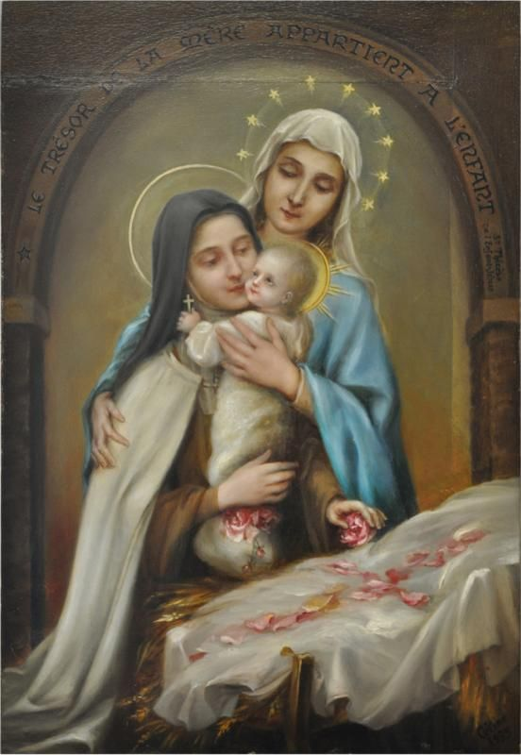
Acting as Jesus’ mother on earth
“To see the feast of [the Assumption of] our Queen Mama, one had to look inside that Sun, so much did the Most Holy Virgin appear immersed in God; in fact, in looking from other points, one could see nothing. Now, while I [Luisa] was in this state of annihilation before that Divine Sun, Baby Jesus, being held in the arms of the Queen Mama, told me: “Our Mama is in Heaven; to you, I give the office of acting as my mama on earth.
And since my life is continuously subject to scorns, to poverty, to pains, to the abandonment of men, and my Mama, while being on earth, was my faithful companion in all these pains - not only this, but She tried to relieve Me in everything, as much as Her strengths were capable of -
you too, acting as my mother, will keep Me faithful company in all my pains, suffering in my place as much as you can; and where you cannot reach, you will try to give Me at least a refreshment. Know, however, that I want you all intent on Me. I will be jealous even of your breath if you do not do it for Me.” (Vol 2 - August 15, 1899)
A mother/father soul of Jesus is a faithful companion of Jesus in everything
Focus attentively on Jesus in everything.
When you suffer, focus not on your pain/sorrows but on Jesus and the good that will come from this suffering.

Slide 7
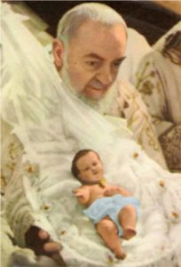
Sing and Praise Jesus in trouble and suffering
“Jesus continues to want me to act as His mother. He made Himself seen as a most gracious little baby, crying; and to calm His crying, holding Him in my arms, I began to sing” (Vol 2 - August 16, 1899)
“With the Harp I Will Solve My Problem” (Psalm 48/49:5, cf. Psalm 13/14)
“Little Baby, You are little and strong, from You I expect every comfort; little Baby, gracious and beautiful, You enamour even the stars;
little Baby, steal my heart so as to fill it with your love; little Baby, tender little one, make me a little baby too;
little Baby, You are a Paradise, O please! Let me come to delight in your eternal smile.” (Vol 2 - August 16, 1899)
Pick your favourite chant, chorus, hymn, or song and change the words to fuse or enhance truths of living in the Divine Will.
For example, “Rein in me, sovereign Lord rein in me” hymn: work in me, sovereign Lord work in me. Suffer in me, sovereign Lord suffer in me. pray in me, sovereign Lord pray in me…

Slide 8
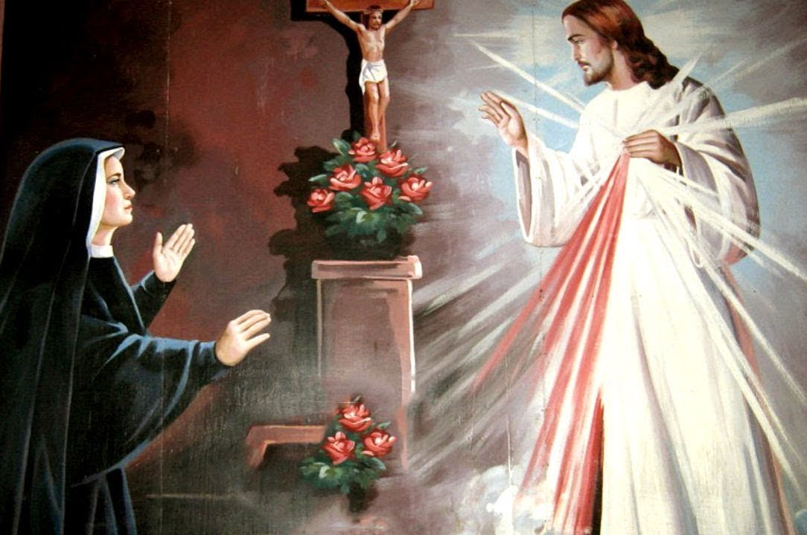
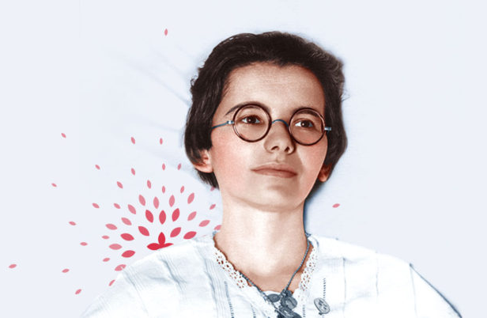
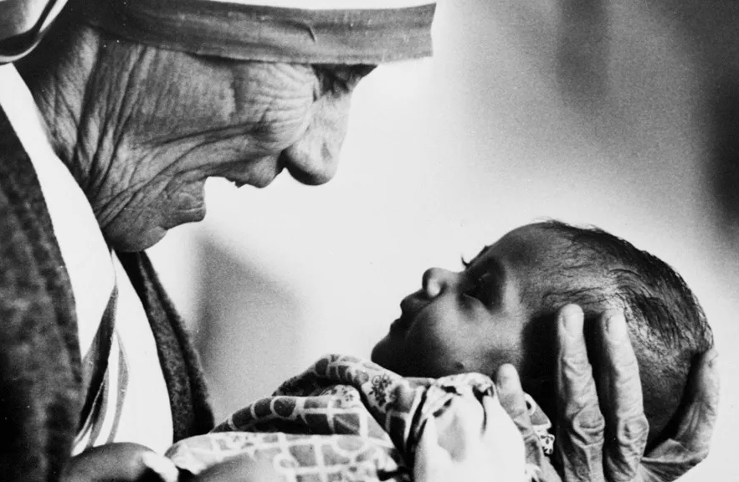
A living Host
“The gift of Living in the Divine Will establishes in the soul Jesus’ “Real Life”. This Real Life is similar to Jesus’ “Real Presence” in the Eucharist, and it is perpetuated in the soul who lives in the Divine Will.” (Manual for Priests, Fr Dr Joseph Iannuzzi)
“You [Luisa] are in your bed, only by the empire of my Fiat. Ah! it is not corporal maladies that keep you hampered – no, but it is my Will alone that wants it so; and making a veil of you, It hides Me and forms for Me a living host, a living tabernacle.” (Vol 25 - October 17, 1928)
"So, to the one who does my Will I say: ‘You are my life, my blood, my bones.’ The true and real sacramental transformation takes place - not by virtue of the words of the priest, but by virtue of my Will. As soon as the soul decides to live of my Volition, my Will creates Myself in the soul;
and as my Will flows in the will, in the works, in the steps of the soul, she undergoes as many of my creations. It happens just as to a pyx full of consecrated particles: there are as many Jesuses for as many particles - one for each particle.
In the same way, by virtue of my Will, the soul contains Myself in her whole being, as well as in each part of it. One who does my Will fulfils the true eternal communion – and a communion with complete fruit.” (Vol 11 - August 20, 1913)
The Saints who received the gift of the DW called souls living in it as “Living Hosts”: St Faustina Kowalska (1905-1938), her confessor Fr Michael Sopocko (1905-1938), St Mother Teresa of Calcutta (1910-1997) and Ven. Marthe Robin (1902-1981); (Fr J Iannuzzi, PhD, p.616)

Slide 9
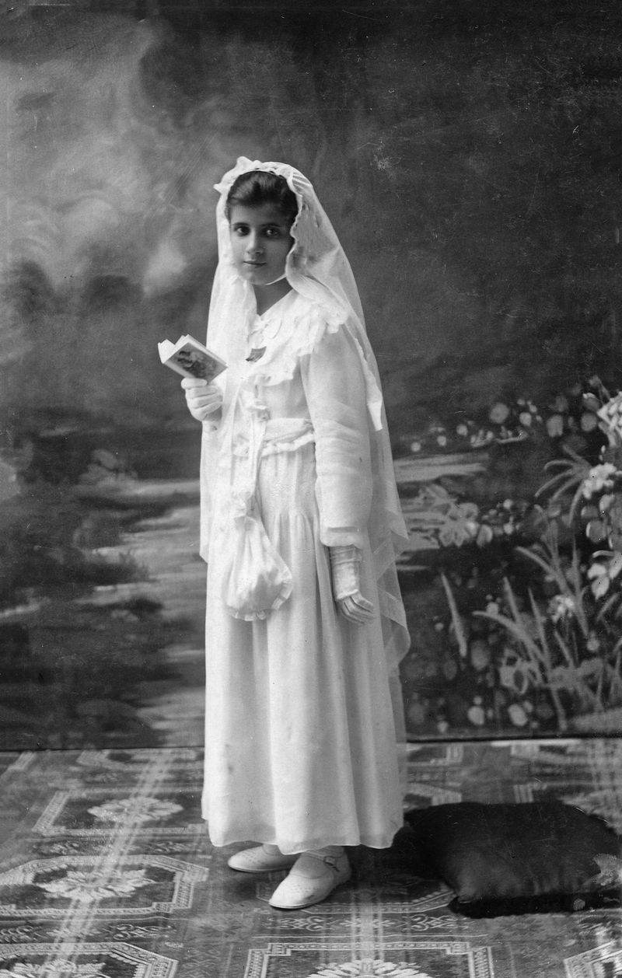
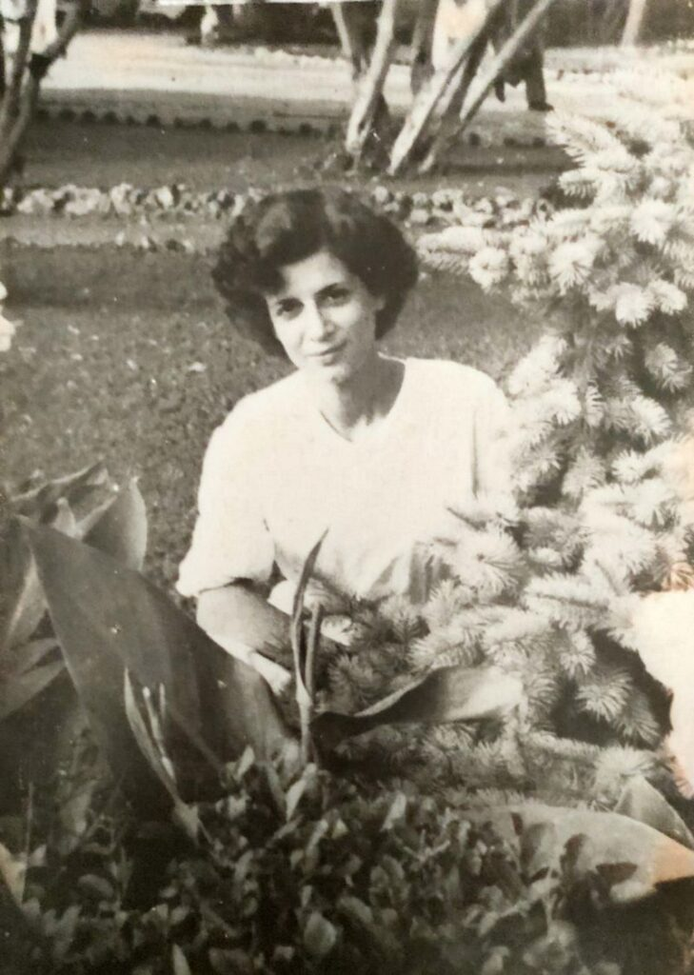
A living Tabernacle
”This is why all my aims, my cares and my interests are in making my Divine Will known, and in making It reign in the midst of creatures; then will each creature be a living tabernacle of mine – not mute, but speaking; and I will no longer be alone, but I will have my perennial company.” (Vol 25, December 2, 1928)
The Servant of God Vera Grita (1923-1969) received the Gift of living in the Divine Will under the name of “Living Tabernacles” (Fr J Iannuzzi, PhD, p.616)
The Lord communicated the Work of the Living Tabernacles to her in the last 2 years of her life. On 19 September 1967, she began the mystical experience that invited her to live fully the joy and dignity of being a child of God, in communion with the Trinity and in Eucharistic intimacy with Jesus received in Holy Communion and present in the Tabernacle.
“The wine and the water are us: you and I, I and you. We are one: I am digging in you, digging, digging to build me a temple: let me work, do not put obstacles in my way […] the will of my Father is this: that I remain in you, and you in me. Together we shall bear great fruit.” There are 186 messages that make up the Work of the Living Tabernacles that Vera, struggling with the fear of being a victim of deception, wrote in obedience to Fr Zucconi.
“Take me with you” expresses in a simple way Jesus’ invitation to Vera. Take me with you where? Where you live: Vera was educated and prepared by Jesus to live in union with Him. Jesus wanted to enter Vera’s life, her family, the school where she taught. An invitation addressed to all Christians. Jesus wants to come out of the Church of stone and wants to live in our hearts with the Eucharist, with the grace of Eucharistic permanence in our souls. He wants to come with us where we go, to live our family life, and he wants to reach out to those who live far from him by living in us.

Slide 10
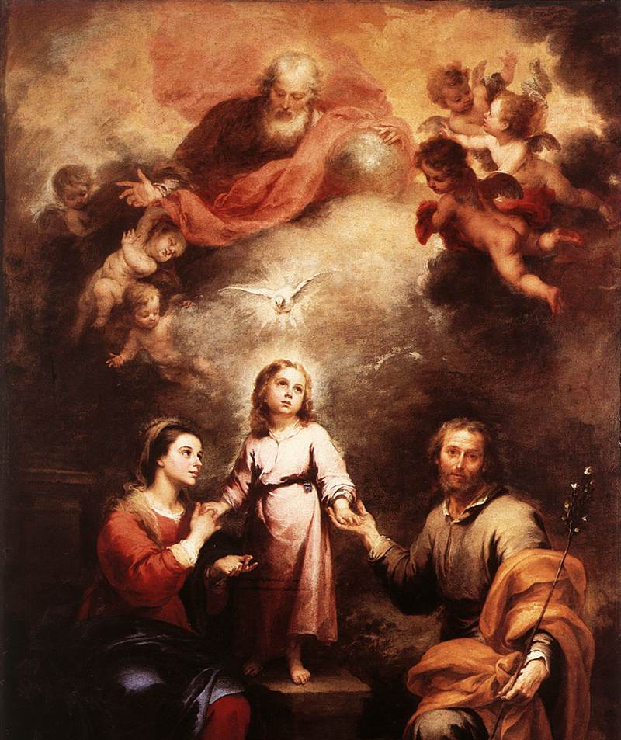
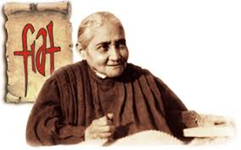
Fiat Voluntas Tua on earth as it is in heaven
“An act in my Will can be a mighty wind, such as to transport and uproot with its strength passions, weaknesses, bad habits, the putrefied air of sin, and substitute them with virtues, divine strength, holy habits, and the sanctifying air of my Will…
An act in Our Will can contain such wonders, that the creature is incapable of comprehending all of its value.”
Jesus became silent, and I remained as though soaked within this sea, and, I don’t know how, I felt myself being transported into the Celestial Fatherland, in the midst of three circles of light, at the top of which there was the Queen of Heaven on one side and Our Lord on the other, with an enchanting beauty and an unspeakable love.
In between these, there was a multitude of souls, all transformed into the light in which they lived and grew, but kept, directed and nourished by Jesus and by the Celestial Mother.
How many beautiful surprises could be seen! These souls possessed the likeness and the Life of their Creator.
And my sweet Jesus and His Mother told me: “These circles of light that you see are a symbol of the Sacrosanct Trinity, and the souls are those who will form the Kingdom of the Divine Will. This Kingdom will be formed within the bosom of the Divinity.
The rulers of this Kingdom will be Us – the Mother and the Son, who will keep It with jealousy. See then, the certainty of this Kingdom - It is already formed because in God things are as though already done.
Therefore pray that what is there in Heaven may be realized on earth.” (Vol 34 - July 25, 1937 )

